Slide 1




HOME-ARP Supportive Services
Tenant Based Rental Assistance
Application

Slide 2



Supportive Services & TBRA
Funding and Caps Consideration
HOME-ARP Supportive Services:
$5,714,149
The anticipated annual award amount for Supportive Services is $952,358.17.
HOME-ARP Tenant Based Rental Assistance (TBRA):
$7,714,100
The anticipated annual award amount for TBRA is $1,285,683.33.

Slide 3
Supportive Services & TBRA
Funding and Caps Consideration
Funding limits for Supportive Services is between $75,000 and $300,000
Funding limits for TBRA is $100,000 to $500,000
However, it is important to note that the caps do not ensure that your agency will receive the exact amount requested. The final amount awarded depends on the available funds and the number of agencies receiving funding, and the agencies’ financial capacity.
It is possible for agencies to receive less than $75,000 in their contract award.

Slide 4
Application Cycle
The HOME-ARP application for TBRA and Supportive Services is a one-time application that can be renewed annually by awarded agencies until September 30, 2029, based on their previous year's performance and funding availability. Additionally, funds not expended during the first contract term may move forward to the next grant year.

Slide 5
Spending Goals
Awarded applicants must be in “good standing” to be eligible for program renewal each year.
Agencies are required to spend at minimum 60% of the grant expended on an annual basis to 2027. By grant year end of 2028, 90% of agencies funds must be expended, and by grant year end of 2029, agencies must be spending 100% of their funds on time to meet the expenditure deadline of August 31, 2030.

Slide 6
Not Meeting Spending Goals
Agencies not able to meet the annual expenditure goals will be placed on a grant probation the following year. Agencies on grant funding probation may receive a renewal contract; however, they must meet the expenditure goal by the end of that grant term. If the agency on grant funding probation is unable to meet the expenditure goal by the end of the probation year, their contract will not be considered for renewal.
Agencies not meeting their expenditure goals by the end of the grant year 2027 will not be renewed and will be required to expend their remining funds by the contract deadline. MHC reserves the right to award reduced contracts to agencies not meeting expenditure goals based on the community needs.

Slide 7
Recapture of Funds
The Corporation may recapture funds previously awarded to a HOME-ARP recipient. The Corporation may reallocate any recaptured funds to agencies receiving HOME-ARP funds and providing like services. Requests for supplemental funds will be considered on a case- by-case basis with funds granted only in those instances where the Corporation can readily determine that additional funding is justified.

Slide 8
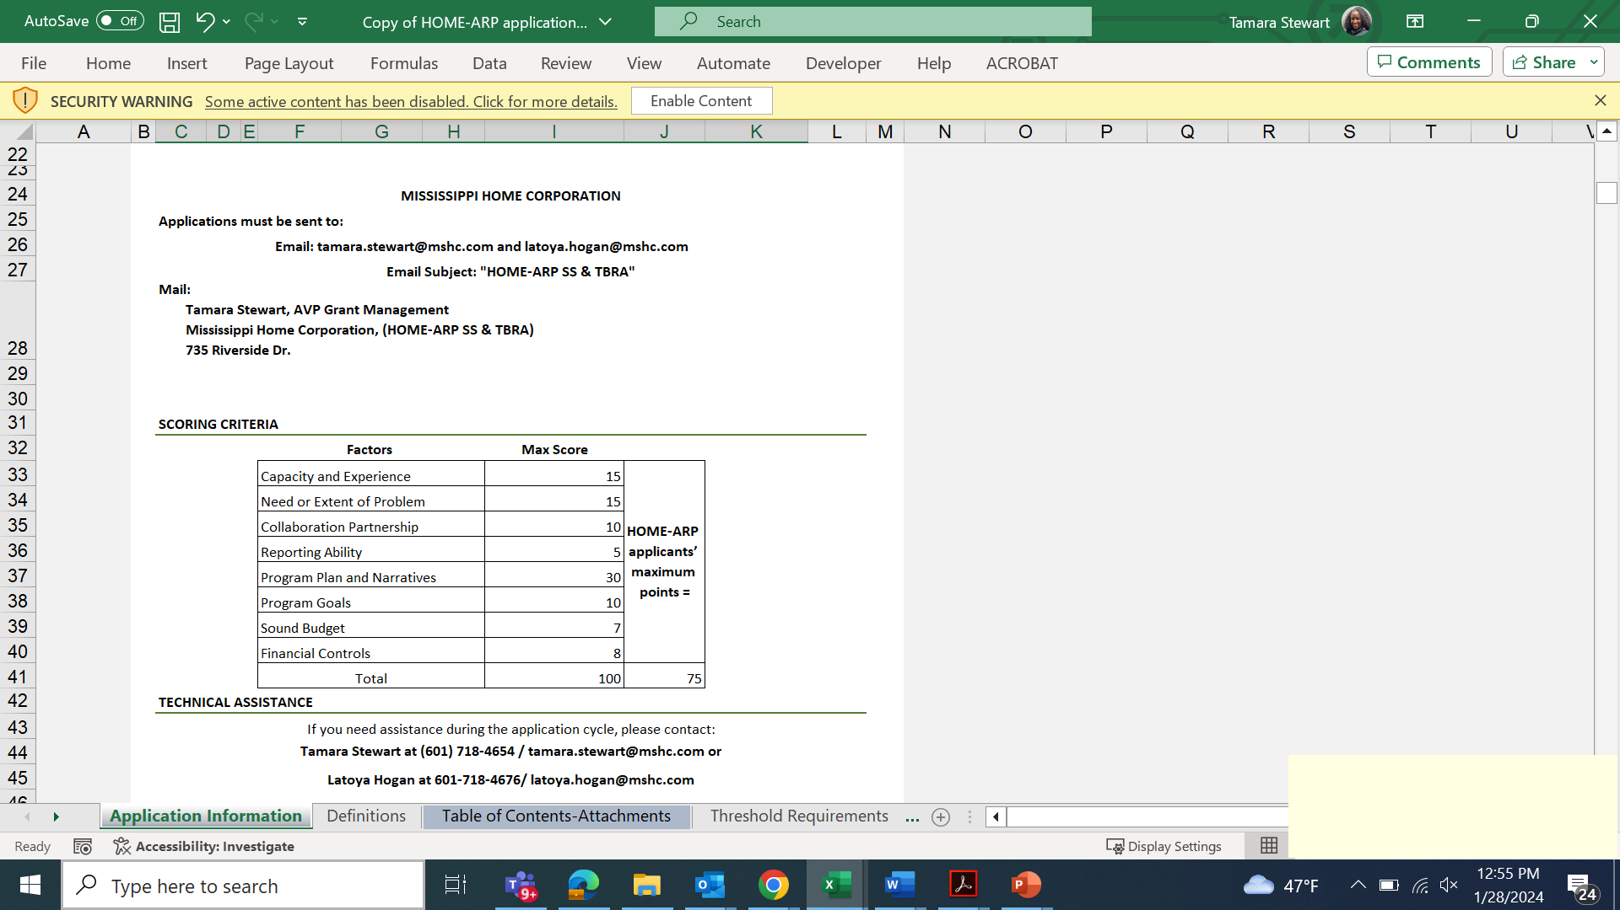
Navigating the Application
Each tab represents a section that collects information about the project. These sections ask questions related to eligible activities and spending plans.
Some tabs are information only.
Total of 21 tabs

Slide 9
Racial Equity

Slide 10

Table of Contents
The application must be submitted according to the table of content.
  Keep all attachments in order
  Include a title page for each section

Slide 11
Threshold Requirements
Eligible Agencies :
Must meet threshold requirements and have supporting documents to very that they meet threshold

Slide 12
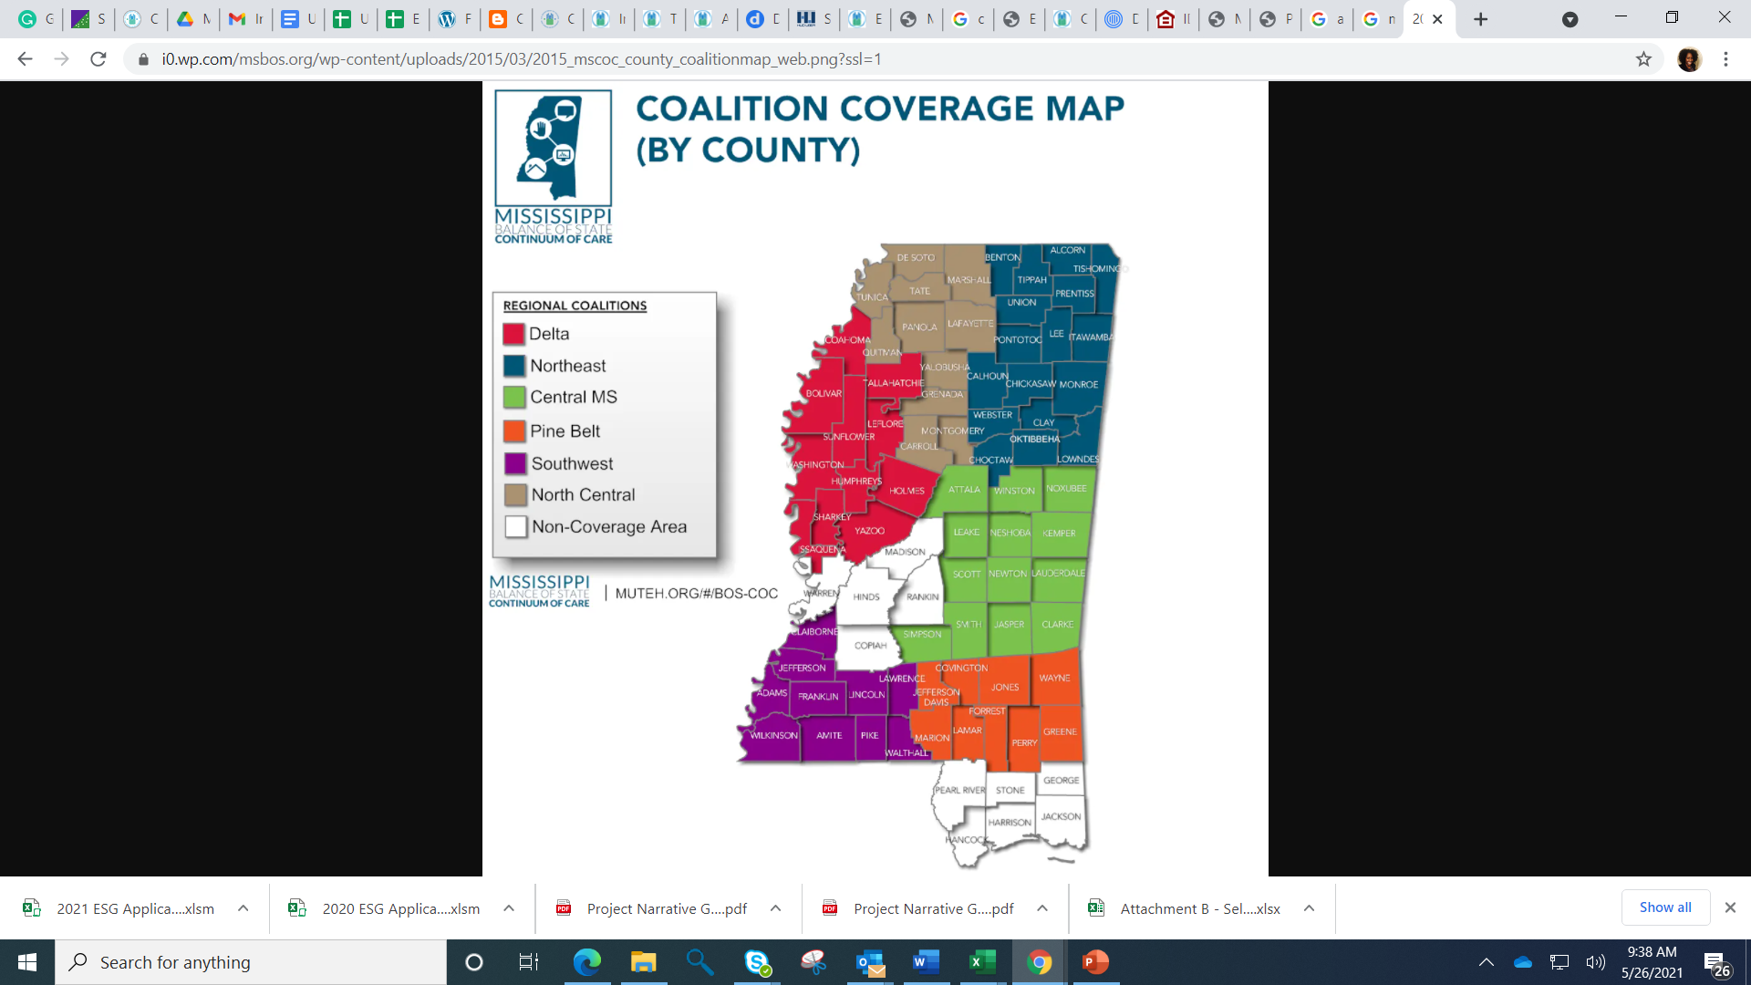

Applicant Information
Balance of State
Central CoC
Open Doors
Homeless Coalitions
Notes:
Tamara

Slide 13
Eligibility
Is my agency eligible for funding?

Slide 14
Program Plan and Narrative 30 pts
In the application, points will be given to agencies who have a well develop plan for providing services and transitioning applicants to housing stability and self-sustainability.
The points for the Program Plan and Narrative will be taken from the “Program Description” tab, and “Project Info” tab in the application.

Slide 15
Project Description 10 pts
Describe the proposed program.
Identify the need and describe how the proposed program can provide resolution.
Describe how the proposed program will operate in detail. The description should include how clients are referred and what types of services are provided from entry to exit of the proposed program
Provide a description of the draw and reimbursement process.

Slide 16
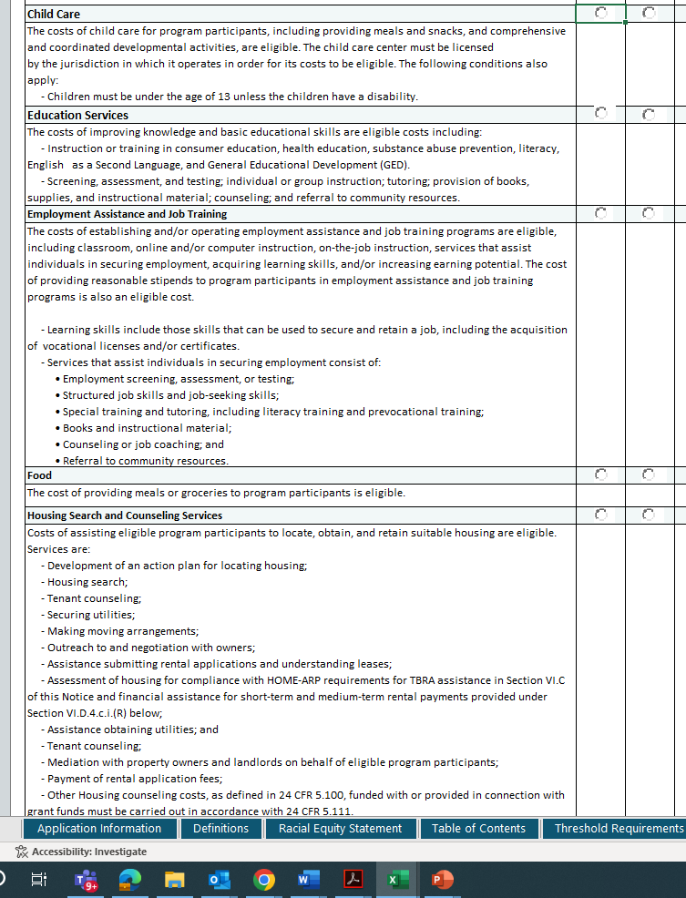
Project Information
Select the supportive services activity your agency will provide.

Slide 17
Project Information 20 pts (10 pts per tab)
Describe your experience with the QP.
Describe how your requested services will be used to promote stability.
Describe employment efforts (provided directly or through partnerships)
Describe community coordination of services.
  How does community coordination help improve services.
Does your program lead to permanent/stable housing discharges or are you connected to community services for housing stability?
  What support is provided to prevent future housing loss

Slide 18
Project Information 20 pts (10 pts per tab)
Identify methods to recruit landlords. Max points if you have existing partnerships with Developers and Tax Credit properties.
What are your case management and discharge practices.
Describe how services will connect through HOME-ARP programs. Will you partner with HOME-ARP rental developers to provide support services and TBRA?

Slide 19
Project Information: TBRA
Complete the TBRA tab only if you will provide TBRA services.
Extra points will not be provided for providing TBRA
TBRA budget

Slide 20
Reporting 5pts
Describe the proposed program.
Identify the need and describe how the proposed program can provide resolution.
Describe how the proposed program will operate in detail. The description should include how clients are referred and what types of services are provided from entry to exit of the proposed program

Slide 21
Reporting Ability – 5 pts
Project Info E
Describe their current data collection and reporting systems.
What data collection system do your agency use (HMIS, other)?
  Is your reporting system HIPAA compliant?
What data analysis and reports are conducted by the agency?
Describe what processes are in place for tracking program outcomes.
Describe how the proposed program outcomes and performance is/will be measured.

Slide 22
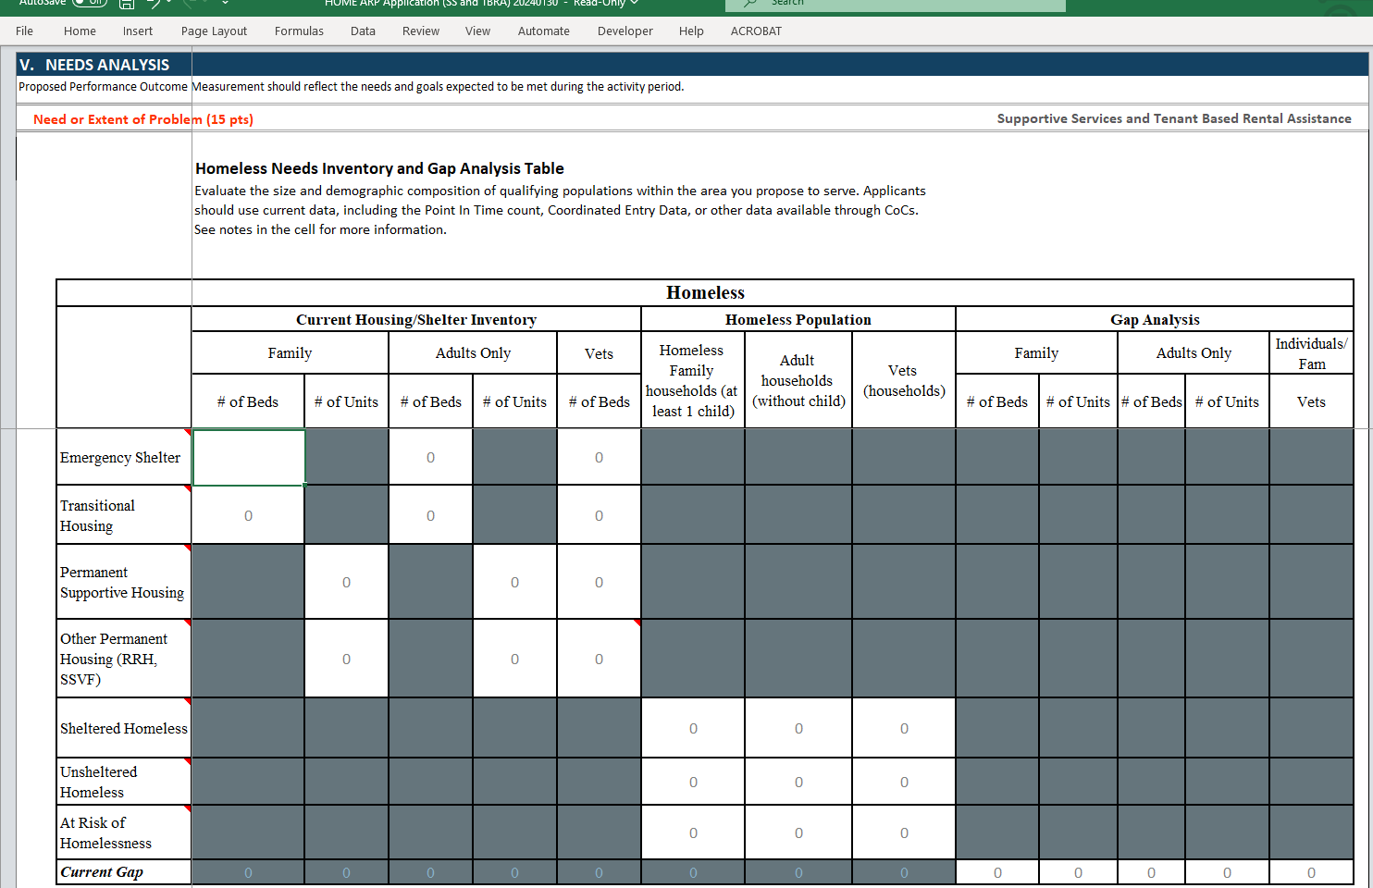
Need Analysis 15 pts

Slide 23
Program Goals– 10 pts
In the application, points will be given to agencies whose program goals are clearly described and are in line with the state’s HOME-ARP allocation plan goals, MHC goals and ConPlan.
Agencies can describe their goals on the “Proposed Goals” tab, and “Program Description” tab in the application.
Proposed Goals
  In the application define your agencies quarterly production goals for providing Supportive Services and/or TBRA assistance.

Slide 24
Sound Budget Financial Controls -15 points
Project Budget Tabs
Agencies are marked on their financial controls and feasibility to manage the HOME-ARP reimbursement grant. Agencies can describe their financial controls on the “Project Budget” tab.
  Financial Capacity – 8 pts
  Sound Budget – 7 pts

Slide 25
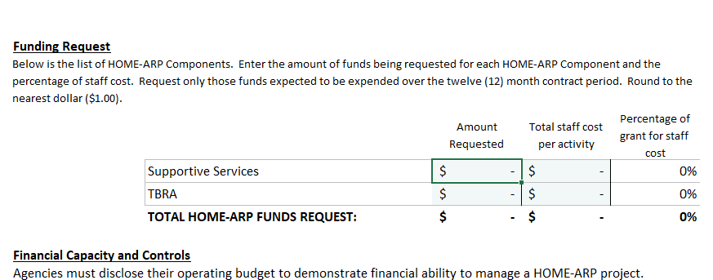
Financial Controls: 8 pts
What percent of your budget is for staff cost?
The staff cost on your total request must match the staff cost on your budget breakdown.

Slide 26

Financial Controls: 8 pts
Describe the sources of funds that are available for the proposed program; describe matching funds; discuss how funding sources will be used if HOME-ARP is not funded.
Describe budgeting priorities/activities to stretch HOME-ARP funds through the grant period.
** In your “Program Description”***
  Provide a description of the draw and reimbursement process.
These pages talk to each other

Slide 27
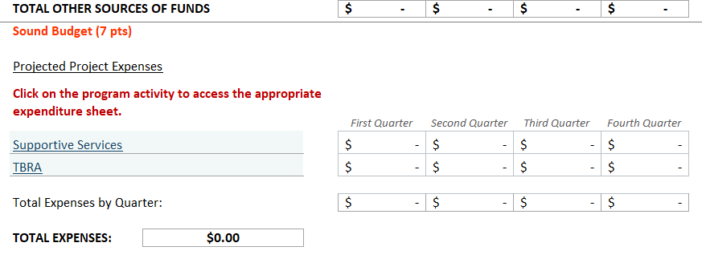
Sound Budget: 7 pts
Agencies must provide a reasonable and appropriate budget.
Click here
Must match
Total request

Slide 28
Budget Worksheet SS and TBRA

Slide 29
Budget Summary
Pages that talk
Open fields: Cash on hand, non-project related expenses
Project Budget & Budget Summary

Slide 30
Capacity and Experience 15 pts.
The Capacity and Experience tab took the place of attachment A
Capacity and Experience (20 pts)
APPLICANT EXPERIENCE & CAPACITY
Mississippi Home Corporation (MHC) gives point preference to applicants whose key staff members (Executive Director, Case Manager and Finance Staff) have previous experience in managing projects with federal, state and local funding sources. Applicants may receive up to fifteen (15) points based on the number of years of experience. MHC reserves the right to verify all information.
Applicant
Applicant Entity: |  | 0
Business Address:
Contact Person:
Phone: |  |  |  | Email:
Key Staff Member (Please complete one form for each Key Staff Person)
Name:
Title:
Role in Proposed Project:
Previous Experience
List all previous experience that the Key Staff Member has with federal, state, or local projects within the past five (5) years.
Award Year | Project Source of Funds |  | Funding Amount | All Funds Expended? (Y/N) | Project Activity | No. of People Served | Closed-Out (Y/N) | Number of findings associated with the grant (if any)
Max points can be obtained if the agency has five or more years of experience in administering federal grants, has experienced key staff overseeing their grants, has sufficient staff to operate the program, and has the financial capacity to operate a reimbursement grant.

Slide 31
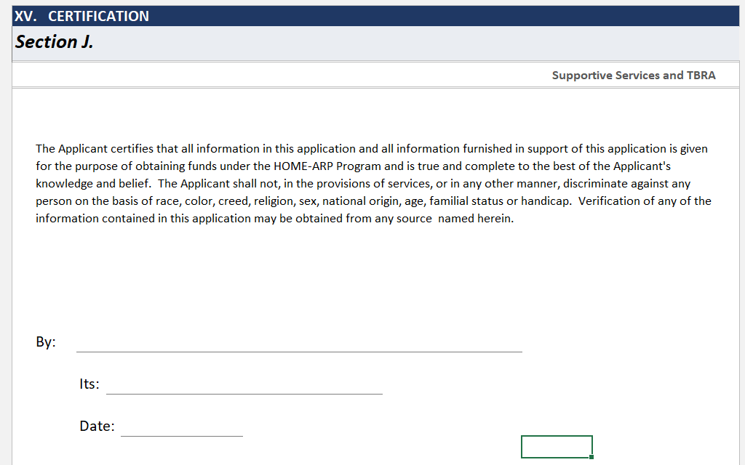
Certification
The Certification tab is the completion of the application, and it must be signed.

Slide 32
You did it!

Slide 33




Comparison of HOME-ARP qualifying populations vs. CoC/ESG eligible participants

